Slide 1


Digital Control in Power Electronics
杭丽君
ljhang@hdu.edu.cn
2018/7/15
可再生能源及微型电力网技术实验室
Regeneration energy and microgrid Technology Lab(REMT)

Slide 2
课 程 内 容
Introduction: Digital Control Application to Power Electronic Circuits
The Test Case: a Single-Phase Voltage Source Inverter
Digital Current Mode Control
Extension to Three-Phase Inverters
External Control Loops

Slide 3
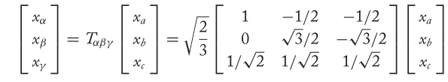
4.1 THE αβ TRANSFORMATION

Slide 4
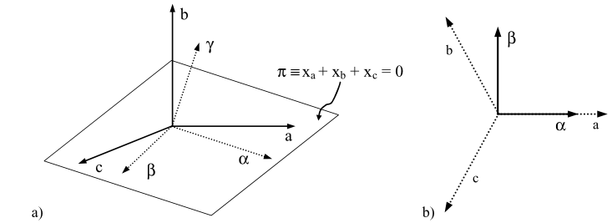
4.1 THE αβ TRANSFORMATION

Slide 5
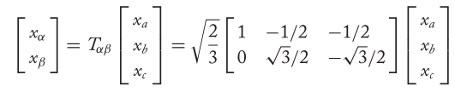
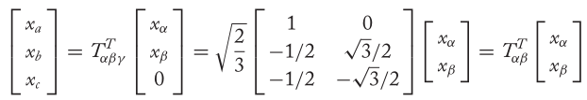
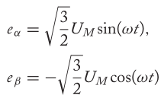

4.1 THE αβ TRANSFORMATION

Slide 6
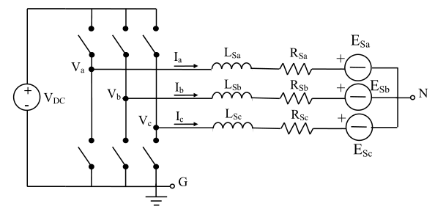

4.2 SPACE VECTOR MODULATION
Three-phase VSI simplified schematic:
The length of each projection determines the fraction δ of the modulation period that will be occupied by each output vector:

Slide 7
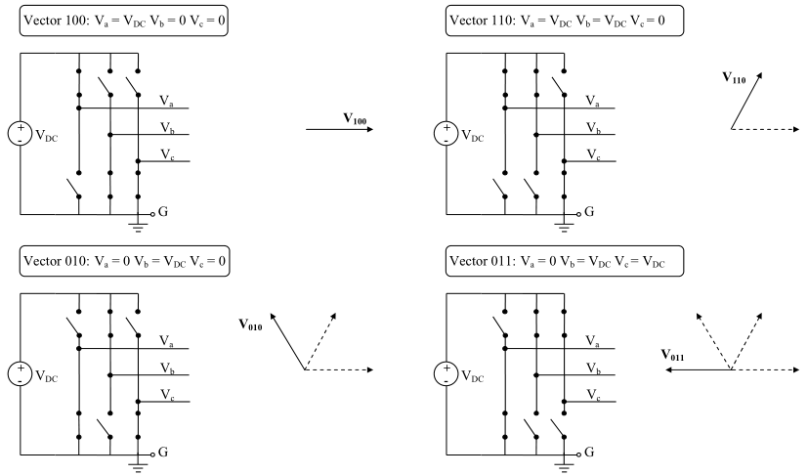
4.2 SPACE VECTOR MODULATION
Three-phase inverter output voltage vectors and their projection on the plane π:

Slide 8
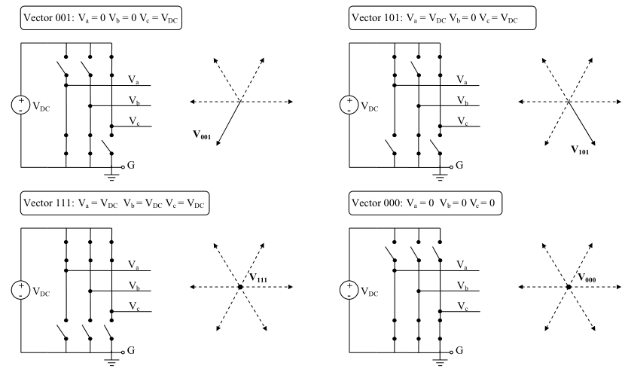
4.2 SPACE VECTOR MODULATION

Slide 9
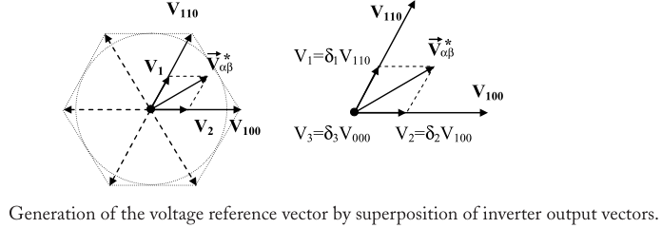

4.2 SPACE VECTOR MODULATION

Slide 10
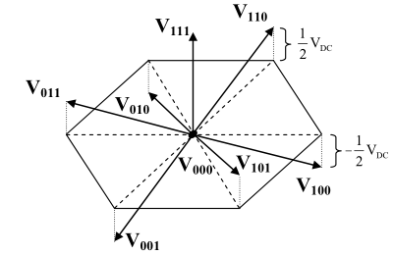
4.2 SPACE VECTOR MODULATION
Tridimensional view of the space vector hexagon.

Slide 11
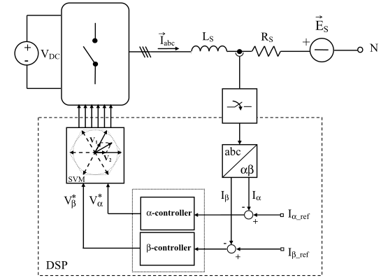
4.2.1 Space Vector Modulation Based Controllers
Organization of a three-phase digital current controller based on SVM.

Slide 12
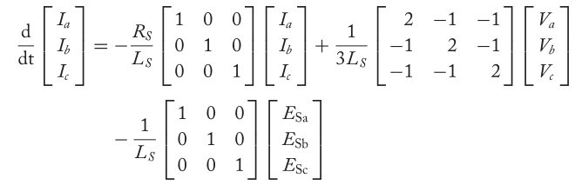


4.2.1 Space Vector Modulation Based Controllers

Slide 13
4.3 THE ROTATING REFERENCE FRAME CURRENT CONTROLLER
While this is not possible for the dead-beat controller, which already provides the best possible dynamic response among digital current regulators, in the case of the PI current controller the answer to the above question is affirmative. The implementation of the so-called rotating reference frame controller indeed allows a significant improvement of the reference tracking capabilities of the PI regulator.

Slide 14
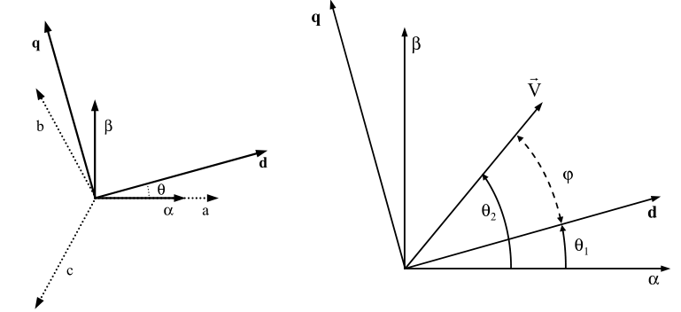
4.3.1 Park’s Transformation
Vector diagrams for Park’s transformation.

Slide 15
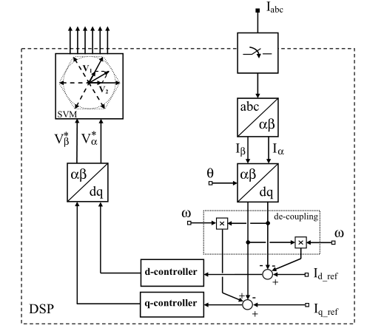



4.3.1 Park’s Transformation
Organization of a three-phase digital current controller in the dq reference frame.

Slide 16
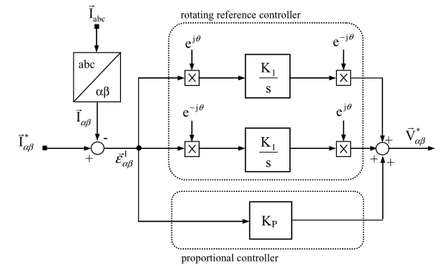
4.3.2 Design of a Rotating Reference Frame PI Current Controller
Organization of the rotating reference controller in the continuous time domain.

Slide 17
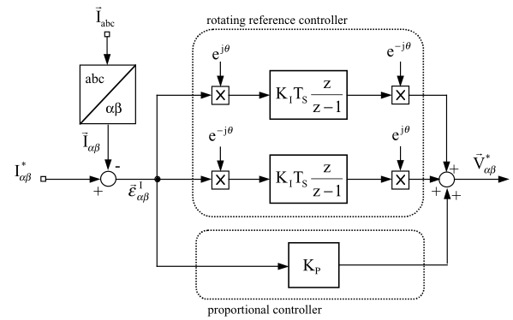
4.3.2 Design of a Rotating Reference Frame PI Current Controller
Discretized version of the rotating reference PI current controller.

Slide 18

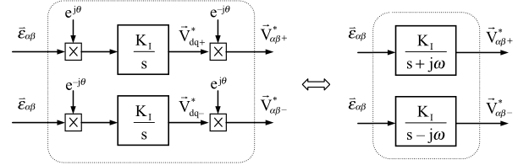
4.3.3 A Different Implementation of the Rotating Reference Frame PI Current Controller
Laplace transformation of the rotating reference controller.

